Slide 1
OBD II PC TOOL

Slide 2
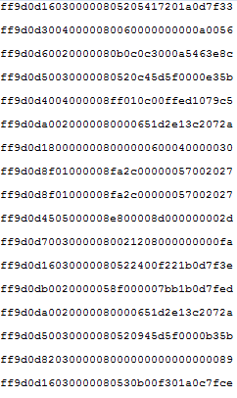
DATA using OBD scanner [Hyundai Grandger]
Hyundai Sonata Car Log Data
click it
click it
::ff9d0d50030000080520945d5f0000b35b
CAN DEBUG-MODE | 2 Byte | FF9D
Length | 1 Byte | 0D(13) 50030000080520945d5f0000b3
PID | 4 Byte | 00000350 -50030000
Length | 1Byte | 08(8) - 0520945d5f0000b3
DATA | 8Byte | 0520945d5f0000b3
CRC | 1Byte | 5b

Slide 3
ff9d0d4004000008ff010c00ffed1079c5 (PID for Speed : 0x440 )
CAN DEBUG-MODE | 2 Byte | FF9D
Length | 1 Byte | 0D(13) 4004000008ff010c00ffed1079
PID | 4 Byte | 0x440- 40040000
Length | 1Byte | 08(8) - ff010c00ffed1079
DATA | 8Byte | ff010c00ffed1079
CRC | 1Byte | c5
ff9d0d160300000805205417201a0d7f33 (PID for Speed : 0x316)
CAN DEBUG-MODE | 2 Byte | FF9D
Length | 1 Byte | 0D(13) 160300000805205417201a0d7f
PID | 4 Byte | 0x316- 16030000
Length | 1Byte | 08(8) 05205417201a0d7f
DATA | 8Byte | 05205417201a0d7f
CRC | 1Byte | 33

Slide 4
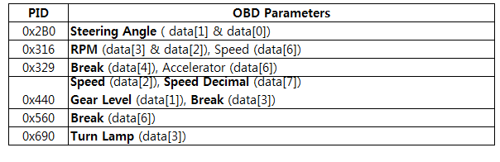
Hyundai Motor PID

Slide 5
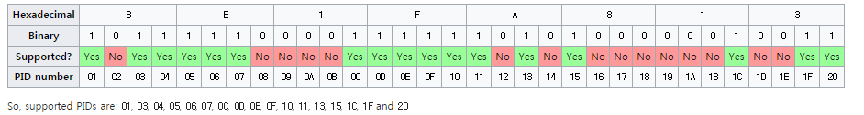
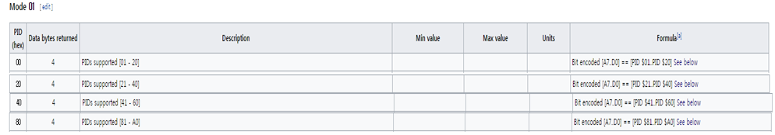
OBD DATA LOG FORMAT
Standard data Verification and Collection https://en.wikipedia.org/wiki/OBD-II_PIDs
Request data : speed / RPM / ……… / Other data
2nd Version(TBD)
RPM
SPEED

Slide 6
OBD DATA LOG FORMAT
Turn Lamp (Left)
ff9d0d30040000080060000000000a00561
ff9d0d30040000080060000000000a0056
ff9d0d60020000080b0c0c3000a5463e8c
ff9d0d50030000080520c45d5f0000e35b
ff9d0d4004000008ff010c00ffed1079c5
ff9d0da0020000080000651d2e13c2072a
ff9d0d1800000008000000600040000030
ff9d0d8f01000008fa2c00000057002027
ff9d0d8f01000008fa2c00000057002027
ff9d0d4505000008e800008d000000002d
ff9d0d70030000080021208000000000fa
ff9d0d16030000080522400f221b0d7f3e
ff9d0db0020000058f000007bb1b0d7fed
ff9d0da0020000080000651d2e13c2072a
ff9d0d50030000080520945d5f0000b35b
ff9d0d8203000008000000000000000089
ff9d0d16030000080530b00f301a0c7fce
ff9d0df004000008201c168000c25f08c3
ff9d0d4505000008e891008e00000000bf
ff9d0d600200000812353630009ca46013
ff9d0d8f01000008fa2c00000054002024
ff9d0df004000008201b2c8000c25f08fe
ff9d0d30040000080060000000000a0056
Input Data set
xxxx_xxxx_normal.log
xxxx_xxxx_turn_left.log
xxxx_xxxx_turn_right.log
xxxx_xxxx_brake.log
xxxx_xxxx_acclerator.log
xxxx_xxxx_steering_left.log
xxxx_xxxx_steering_right.log
2) Output Data ( PID )
Turn Signal
Brake
Accelerator
RPM ( from accelerator data)
Speed
Steering wheel angle

Slide 7
OBD Data Analysis Tool
List of Supported car
New OBD data

Slide 8
List of PID for Valid car
Brand | Car model | Year | Car model ID | Speed | RPM | Turn signal | Brake | Accelerator | Steering | Standard OBD (TBD) | Updated date
Hyundai | Sonata | 2014 | 00067 | o | o | x | x | x | o | o | 2017.03.21

Slide 9
New OBD Data Analysis
Exit
①
②
C:\download\test
Select folder
③
Show New data
Sort by PID
Analysis with two files
Analysis with DB
Analysis with New data
File name
OBD data
PID
Data
④ : Display file name, Raw data, PID, Data
xxxx_xxxx_normal.log
xxxx_xxxx_normal.log

Slide 10
New OBD Data Analysis
Exit
Sort list : All / Normal / Turn signal / Brake / Accelerator/Steering wheel
C:\download\test
Select folder
Show New data
①
Sort by PID
Analysis with two files
Analysis with DB
Analysis with New data
PID
②
③
xxx
Sort
File name
OBD data
PID
Data
ff9d0d5301000008200010ff00ff002e44
Left signal Data log file
ff9d0d5301000008200010ff00ff305e04
ff9d0d5301000008200010ff00ff204e04
Left signal Data log file
ff9d0d5301000008200010ff00ff002e44
ff9d0d5301000008200010ff00ff305e04
ff9d0d5301000008200010ff00ff204e04
④ : display the information for specific PID

Slide 11
New OBD Data Analysis
Exit
Sort list : All / Normal / Turn signal / Brake / Accelerator/Steering wheel
C:\download\test
Select folder
Show New data
①
Sort by PID
Analysis with two files
Analysis with DB
Analysis with New data
PID
②
③
xxx
Sort
File name
OBD data
PID
Data
ff9d0d5301000008200010ff00ff002e44
Left signal Data log file
ff9d0d5301000008200010ff00ff305e04
ff9d0d5301000008200010ff00ff204e04
Left signal Data log file
ff9d0d5301000008200010ff00ff002e44
④ : In case of the same PID, Data change value is blinking
ff9d0d5301000008200010ff00ff305e04
ff9d0d5301000008200010ff00ff204e04

Slide 12
New OBD Data Analysis
Exit
Sort list : All / Normal / Turn signal / Brake / Accelerator/Steering wheel
C:\download\test
Select folder
Show New data
Sort by PID
①
Analysis with New data
Analysis with two files
Analysis with DB
PID
xxx
Sort
File name
OBD data
PID
Data
ff9d0d5301000008200010ff00ff002e44
② : SAME
PID
④ : Need to define Different DATA
FILE1 & FILE 2
ff9d0d5301000008200010ff00ff305e04
ff9d0d5301000008200010ff00ff204e04
FILE1
ff9d0d5301000008200010ff00ff002e44
③: Different
PID
ff9d0d5301000008200010ff00ff305e04
ff9d0d5301000008200010ff00ff204e04
FILE2
ff9d0d5301000008200010ff00ff002e44
ff9d0d5301000008200010ff00ff002e44
ff9d0d5301000008200010ff00ff002e44

Slide 13
New OBD Data Analysis
①
Show New data
Sort by PID
Analysis with two files
Analysis with DB
Analysis with New data
④
Select DB
Car model
Similarity
Matched PID
③
000125 Hyundai Genesis
Speed : xxxxx
RPM: xxxxx
Turn signal: xxxxx
Brake: xxxx
Accelerator: xxxxx
Steering: xxxxx
100 %
000129 Hyundai Excel
Speed : xxxxx
RPM: xxxxx
Turn signal: N/A
Brake: xxxx
Accelerator: xxxxx
Steering: xxxxx
83 %
No data for Excel
② : Display the result for data analysis
- Read the exgisting car model data
- match the data of PID in the existing car mode to new data
(Speed, RPM, Turn Signal, Brake, Accelerator, Steering)
Check the data with existing PID
No data for excel or
Mismatch for both

Slide 14
New OBD Data Analysis
Show New data
Sort by PID
Analysis with two files
Analysis with DB
Analysis with New data
Turn Signal
Compare the different data for same PID between normal.log and turn_left.log and turn_right.log per user
- Check the data which is valid ( 0 / 1 / 2 ). Only take the data which are valid
Sort the results with different user’s data set
Brake
Compare the different data for same PID between normal.log and brake.log per user
- Check the data which is valid ( 0 / 1). Only take the data which are valid
Sort the results with different user’s data set
Accelerator
Compare the different data for same PID between normal.log and accelerator.log per user
- Check the data which is valid ( 0 ~ 99). Only take the data which are valid
Sort the results with different user’s data set

Slide 15
New OBD Data Analysis
Show New data
Sort by PID
Analysis with two files
Analysis with DB
Analysis with New data
4. RPM
Compare the different data for same PID between normal.log and accelerator.log per user
Check the data which is valid ( 0 ~ 3000).
Only take the data which are valid
Sort the results with different user’s data set
5. Speed
Check the PID of RPM.
Check data which is valid ( 0)
Sort the results with different user’s data set
6. Steering wheel
Compare the different data for same PID between normal.log and steering_left.log and Steering_right per user
Check the data which is valid ( - 500 ~ +500).
Only take the data which are valid
Sort the results with different user’s data set

Slide 16
①
New OBD Data Analysis
Show New data
Sort by PID
Analysis with two files
Analysis with DB
Analysis with New data
②
Turn Signal
=> Next
⑤
Order : Turn signal / brake/Accelerator/RPM/speed/ Steering
PID Candidate # of matched Data list Selected PID
xxxxx 2320 0,1,2
④
③ : Display the result for data analysis
- Refer the page 16 ~ page 17
- List up the PID which are the most matched
File list OBD data PID Data
ff9d0d5301000008200010ff00ff002e44
xxxx_xxxx_normal.log
ff9d0d5301000008200010ff00ff305e04
ff9d0d5301000008200010ff00ff204e04
ff9d0d5301000008200010ff00ff002e44
xxxx_xxxx_turn_left.log
ff9d0d5301000008200010ff00ff305e04
ff9d0d5301000008200010ff00ff204e04

Slide 17
New OBD Data Analysis
Show New data
Sort by PID
Analysis with two files
Analysis with DB
Analysis with New data
①
Steering wheel
complete
④
PID Candidate # of matched Data list Selected PID
xxxxx 2320 0,1,2
③
List up the most possible PID(upto 3)
② : Display the result for data analysis
- Refer the page 16 ~ page 17
- List up the PID which are the most matched
File list OBD data PID Data
ff9d0d5301000008200010ff00ff002e44
xxxx_xxxx_normal.log
ff9d0d5301000008200010ff00ff305e04
ff9d0d5301000008200010ff00ff204e04
ff9d0d5301000008200010ff00ff002e44
xxxx_xxxx_turn_left.log
ff9d0d5301000008200010ff00ff305e04
ff9d0d5301000008200010ff00ff204e04

Slide 18
New OBD Data Analysis
Show New data
Sort by PID
Analysis with two files
Analysis with DB
Analysis with New data
Cancel
Verification
②
Verification data locate in the same folder
Item PID Check
Turn signal
Brake
Accelerator
RPM
Speed
Steering Wheel
Xxx
Xxxx
Xxx
Xxxx
Xxxx
xxxx
OK
OK
OK
OK
OK
OK
① : Display the result of analysis
Verification is completed
③

Slide 19
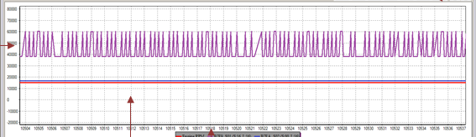
New OBD Data Analysis
Show New data
Sort by PID
Analysis with two files
Analysis with DB
Analysis with New data
Cancel
Verification
Verification data locate in the same folder
Item PID Check
Turn signal
Brake
Accelerator
RPM
Speed
Steering Wheel
Xxx
Xxxx
Xxx
Xxxx
Xxxx
xxxx
OK
OK
OK
OK
OK
OK
Add Vehicle ID for saving data
Vehicle ID
000562
①
② : display car list
③
Toyoya Camry
Save data to DB

Slide 20
When user click, display data by timeline
Various Data filtering
Speed : range ( Km/h or Mile/h )
RPM : range
Gear position / Level : range, integer
Throttle level : range
Brake : 0 or 1
Battery : range
Steering wheel angle : range
Turn Signal : 0/1/2

Slide 21
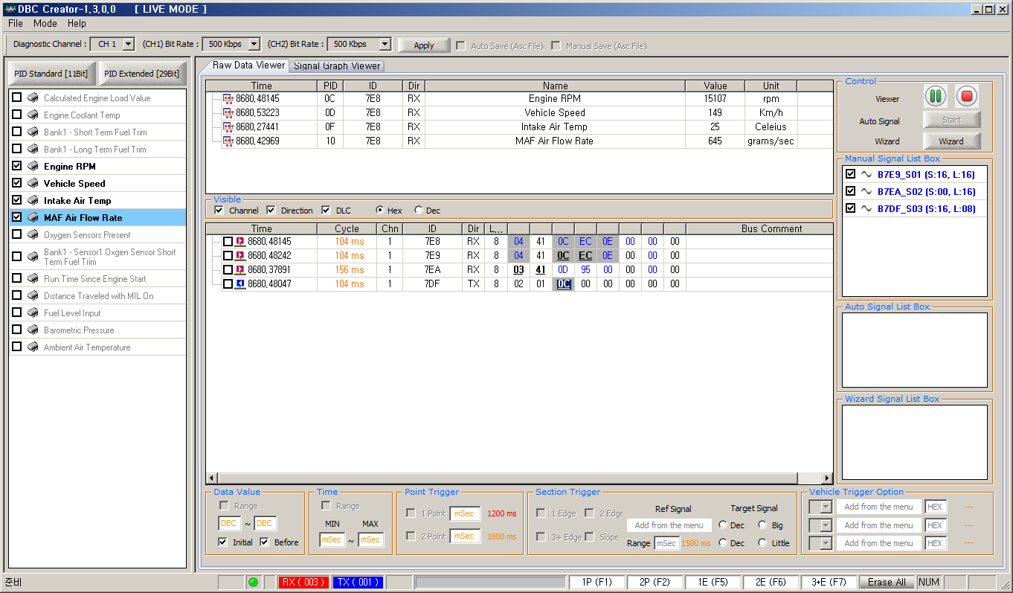
reference

